Slide 1

Phase 1 project AIRCRAFT BUSINESS RISK ASSESSMENT
June Masolo
27/07/25

Slide 2

Table of content
Overview
Business context
Data Exploration and Findings
Recommendations

Slide 3
Overview
Aircraft Business Risk Assessment
Slicken Company is expanding into the aviation industry to diversify its portfolio. This involves purchasing and operating airplanes for commercial and private enterprises. It is therefore imperative that an analysis is undertaken to assess the risks associated with aviation to support business in making informed data-driven decisions to help avert high liability, operational losses, or reputational damage that may occur.

Slide 4
Business Context
Aircraft Business Risk Assessment
Slicken Company currently lacks information about the potential risks associated with different types of aircraft. To support this new venture, a project has been undertaken, tasked with analyzing historical aircraft safety data to identify which aircraft types present the lowest operational risk. The findings will be translated into actionable insights to guide the head of the new aviation division in making informed, data-driven decisions about which aircraft to purchase for both commercial and private operations.

Slide 5
Data exploration and findings
Aircraft Business Risk Assessment
The data used in the analysis was taken from the National Transportation Safety Board, which includes aviation accident data from 1962 to 2023 and selected incidents in the United States and international waters.
The tools used in data exploration include:
Python for data analysis and exploration
Tableau for data visualization
Findings
Amateur-built aircrafts had low accident rates and low fatalities/injuries compared to non-amateur-built aircrafts.
Most accidents occurred when the weather was VMC (minimum airspeed at which a twin-engine aircraft can still be controlled safely if one engine fails, while the other is operating at full power).
Turbo Fan engine had the highest number of recorded survivors at 221,048.
Aircrafts of Cessna, Boeing, and Piper makes recorded the highest rates of fatalities respectively.
Personal flights indicated the highest number of fatalities compared to business, executive and corporate flights.

Slide 6
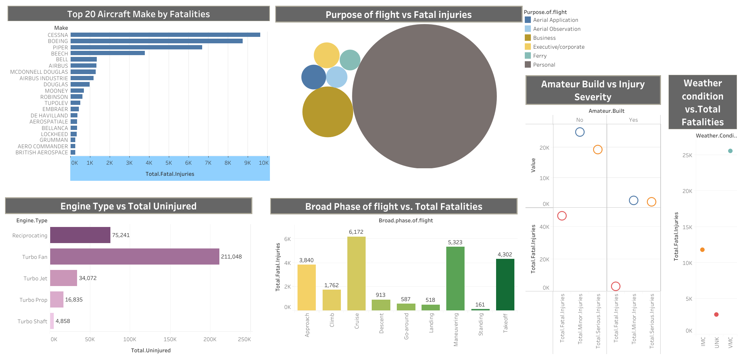
Data exploration and findings cont….

Slide 7
Recommendations
Aircraft Business Risk Assessment
The company should consider buying amateur-built aircrafts since it had low accident rates compared to non-amateur-built aircrafts.
The company should consider investing in Turbo Fan engine aircraft since it had the highest number of recorded survivors.
The company should avoid/minimize the purchase of Aircrafts of Cessna, Boeing, and Piper makes since these have recorded the highest rates of fatalities respectively.
The company should consider investing more in business, executive and corporate flights and less in personal flights since it indicated the highest number of fatalities.

Slide 8

Q&A
Aircraft Business Risk Assessment
Contact person: June Wendy Masolo

